Slide 1

Using Quantum to Calculate a Mixed-Strategy Nash Equilibrium in a Finite Two-player Game
Group: 10
Member: 蘇磐洋、張力元、林予康

Slide 2
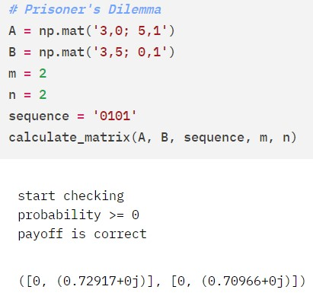
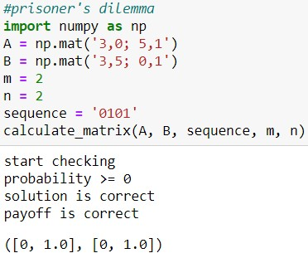
Classical Approach
Done: Prisoner’s dilemma, (rock-paper-scissors game)
Grover’s search, (HHL algorithm)
Difficult to construct oracle

Slide 3
Quantum Approach
Our focus
Done: Prisoner’s dilemma for 2 and 3 players
Multiplayer game (easy)
Multi-strategy game (difficult)
CHSH game (Breidbart basis)
Problem: Don’t know how to find NE efficiently

Slide 4
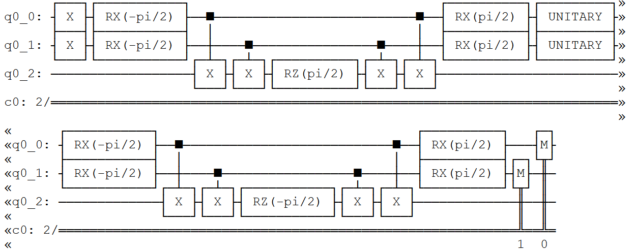
Quantum Approach - 2 player game

Slide 5
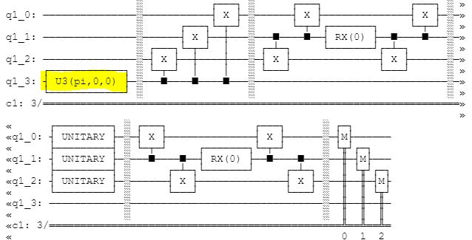
Quantum Approach -3 player game
add a noise gate to simulate the real Quantum device

Slide 6
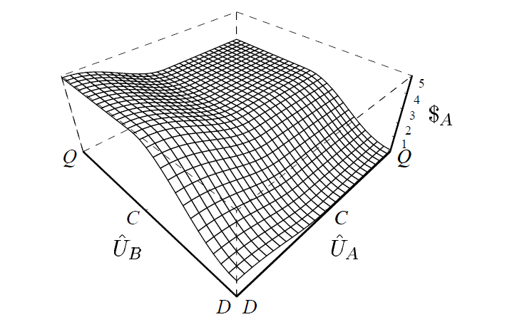
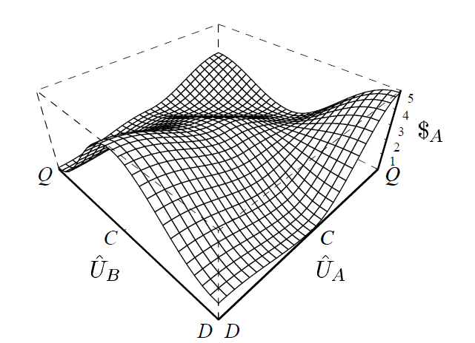
Quantum Approach -2 player game γ = 0, pi / 2
Jens Eisert, Martin Wilkens, and Maciej Lewenstein, “Quantum Games and Quantum Strategies”

Slide 7
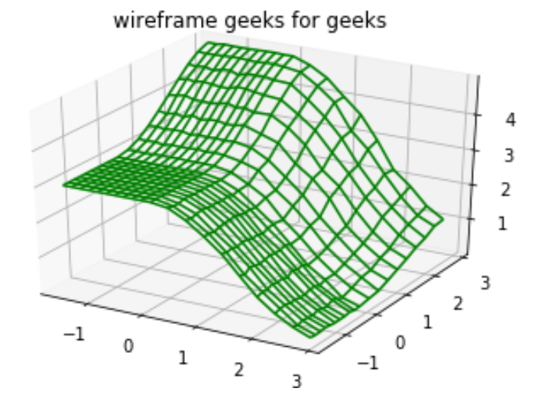
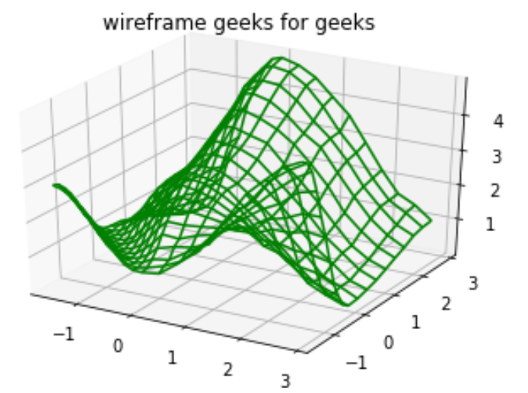
Quantum Approach -2 player game γ = 0, pi / 2
no entanglement
maximal entanglement

Slide 8
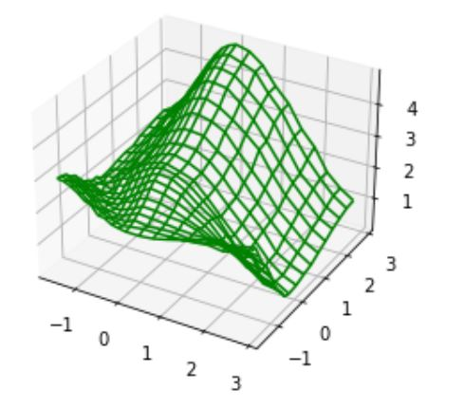
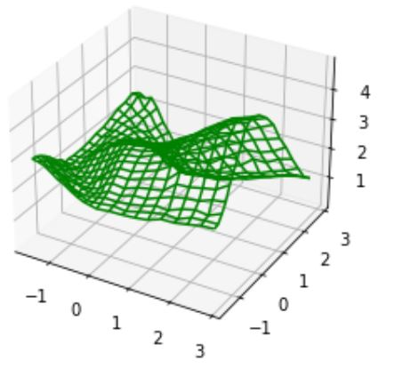
Quantum Approach -2 player game γ = pi / 4
Alice
Bob
half entanglement (Alice)
half entanglement (Bob)

Slide 9
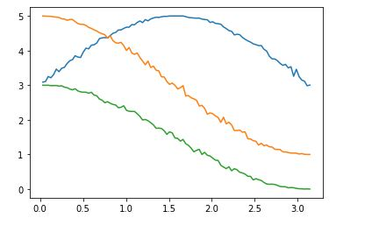
Quantum Approach -2 player game
quantum strategy against classical strategy for maximin value

